Slide 1
Malloc
#include <stdio.h>
#define N_STUDENTS 4
typedef struct student_info {
char name[10];
int height;
float weight;
} student_info;
void swap(student_info s[], int i, int j)
{
student_info tmp;
tmp = s[i];
s[i] = s[j];
s[j] = tmp;
}
selection_sort_byname(student_info s[], int n) {
int i, j, least;
for (i = 0; i < n - 1; i++) {
least = i;
for (j = i + 1; j < n; j++) {
if (strcmp(s[j].name, s[least].name) < 0)
least = j;
}
swap(s, i, least);
}
}

Slide 2
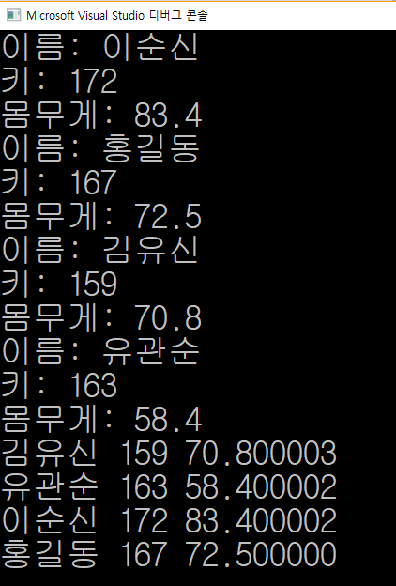
int main(void)
{
int i;
student_info *s;
s = (student_info *)malloc(sizeof(student_info)*N_STUDENTS);
if (s == (student_info *)NULL) {
fprintf(stderr, "malloc fail!!!\n");
exit(1);
}
for(i = 0; i < N_STUDENTS; i++) {
printf("이름: ");
scanf("%s", s[i].name);
printf("키: ");
scanf("%d", &s[i].height);
printf("몸무게: ");
scanf("%f", &s[i].weight);
}
selection_sort_byname(s, N_STUDENTS);
for (i = 0; i < N_STUDENTS; i++) {
printf("%s %d %f \n", s[i].name, s[i].height, s[i].weight);
}
return 0;
}

Slide 3
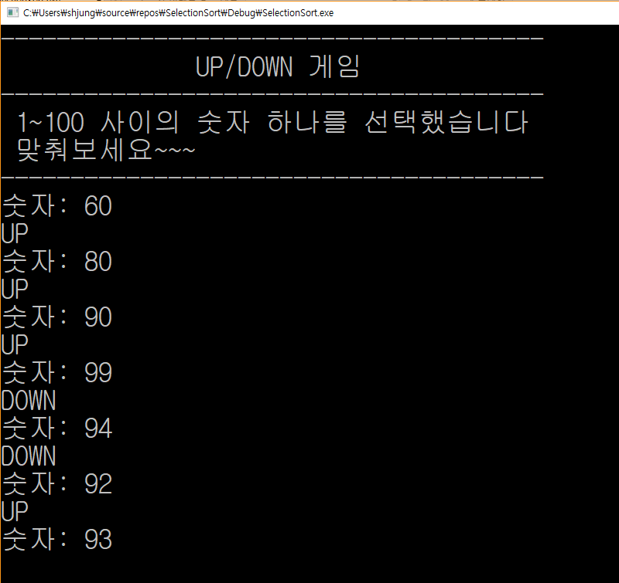
#include <stdio.h>
#include <stdlib.h>
#include <time.h>
int main(void)
{
int i, j, *user;
int num_computer;
srand(time(NULL));
num_computer = rand() % 100 + 1;
user = (int *) malloc(sizeof(int)*100);
if(user == (int *) NULL) {
fprintf(stderr,"malloc fail !!! \n");
exit(1);
}
printf("---------------------------------------\n");
printf(" UP/DOWN 게임 \n");
printf("---------------------------------------\n");
printf(" 1~100 사이의 숫자 하나를 선택했습니다 \n");
printf(" 맞춰보세요~~~ \n");
printf("---------------------------------------\n");
Up/down 게임

Slide 4
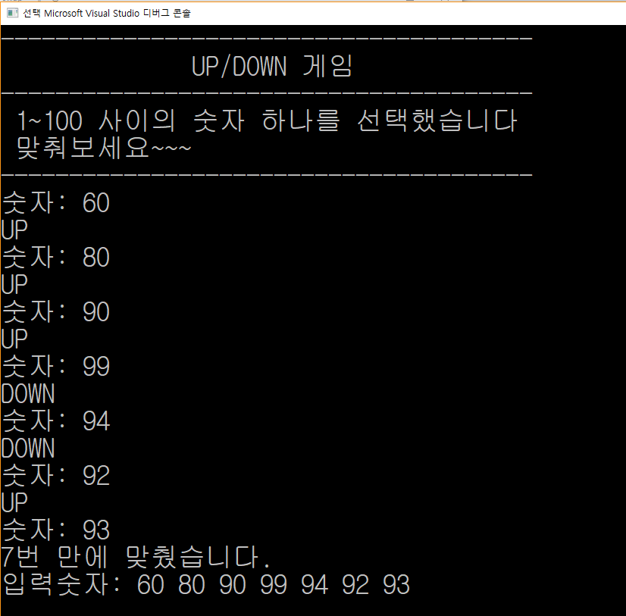
for(i=0; ;i++) {
printf("숫자: ");
scanf("%d",&user[i]);
if(user[i] > num_computer)
printf("DOWN \n");
else if(user[i] < num_computer)
printf("UP \n");
else {
printf("%d번 만에 맞췄습니다.\n",i+1);
printf("입력숫자: ");
for(j=0; j<=i ; j++) {
printf("%d ",user[j]);
}
printf("\n");
break;
}
}
}

