Slide 1
#include <stdio.h>
#include <stdlib.h>
#include <memory.h>
typedef struct TreeNode {
int data;
struct TreeNode *left, *right;
} TreeNode;
TreeNode n1 = { 27, NULL, NULL };
TreeNode n2 = { 34, NULL, NULL };
TreeNode n3 = { 5, NULL, NULL };
TreeNode n4 = { 7, NULL, NULL };
TreeNode n5 = { 78, NULL, NULL };
TreeNode n6 = { 20, NULL, NULL };
TreeNode n7 = { '+', &n1, &n2 };
TreeNode n8 = { '*', &n7, &n3 };
TreeNode n9 = { '-', &n5, &n6};
TreeNode n10 = { '/', &n4, &n9 };
TreeNode n11 = { '-', &n8, &n10 };
TreeNode *root = &n11;
-
*
/
+
5
7
-
27
34
78
20

Slide 2
int get_height(TreeNode *node)
{
int height = 0;
if (node != NULL)
height = 1 + max(get_height(node->left),
get_height(node->right));
return height;
}
int get_leaf_count(TreeNode *node)
{
int count = 0;
if (node != NULL) {
if (node->left == NULL && node->right == NULL)
return 1;
else
count = get_leaf_count(node->left) +
get_leaf_count(node->right);
}
return count;
}
-
*
/
+
5
7
-
27
34
78
20

Slide 3
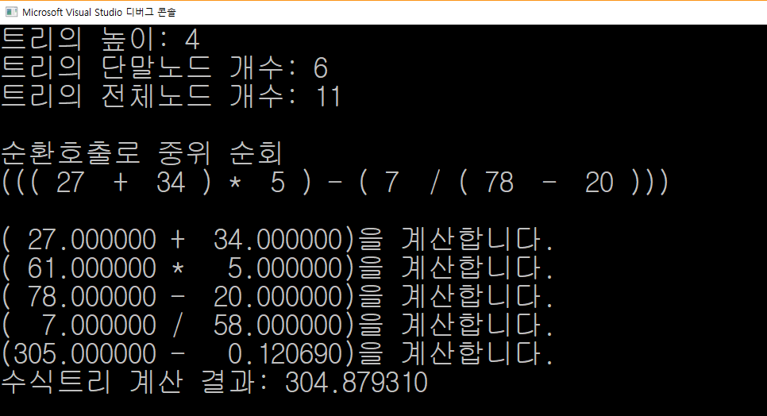
int get_node_count(TreeNode *node)
{
int count = 0;
if (node != NULL)
count = 1 + get_node_count(node->left) +
get_node_count(node->right);
return count;
}
inorder(TreeNode *root) {
if (root) {
int d = root->data; // 노드 방문
if(root->left != NULL || root->right != NULL)
printf("(");
inorder(root->left); // 왼쪽서브트리 순회
if (d == '+' || d == '-' || d == '*' || d == '/')
printf(" %c ", d);
else
printf(" %d ", d);
inorder(root->right); // 오른쪽서브트리 순회
if (root->left != NULL || root->right != NULL)
printf(")");
}
}
-
*
/
+
5
7
-
27
34
78
20

Slide 4
double evaluate(TreeNode *root)
{
if (root == NULL) return 0;
if (root->left == NULL && root->right == NULL)return root->data;
else {
double op1 = evaluate(root->left);
double op2 = evaluate(root->right);
printf("(%10lf %c %10lf)을 계산합니다.\n", op1, root->data, op2);
switch (root->data) {
case '+': return op1 + op2;
case '-': return op1 - op2;
case '*': return op1 * op2;
case '/': return (double)op1 / (double)op2;
}
}
return 0;
}
-
*
/
+
5
7
-
27
34
78
20

Slide 5
int main(void)
{
printf("트리의 높이: %d \n", get_height(root));
printf("트리의 단말노드 개수: %d \n", get_leaf_count(root));
printf("트리의 전체노드 개수: %d \n\n", get_node_count(root));
printf("순환호출로 중위 순회 \n");
inorder(root);
printf("\n\n");
printf("수식트리 계산 결과: %lf\n", evaluate(root));
}
-
*
/
+
5
7
-
27
34
78
20

