Slide 1
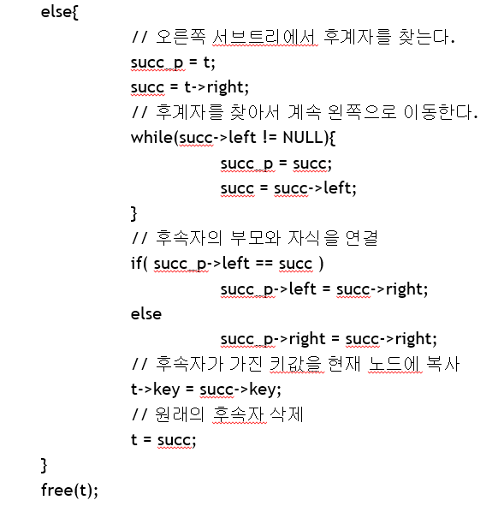
35
35
18
22
7
26
succ_p
7
26
succ_p
succ
22
succ
24
24
35
35
18
succ_p
26
succ_p
7
26
7
succ
30
succ
30

